Slide 1
FINAL YEAR PROJECT MANAGEMENT SYSTEM
ADELINO NTACHO & SHADRACK MBALA

Slide 2
ENTITY RELATIONSHIP DIAGRAM

Slide 3
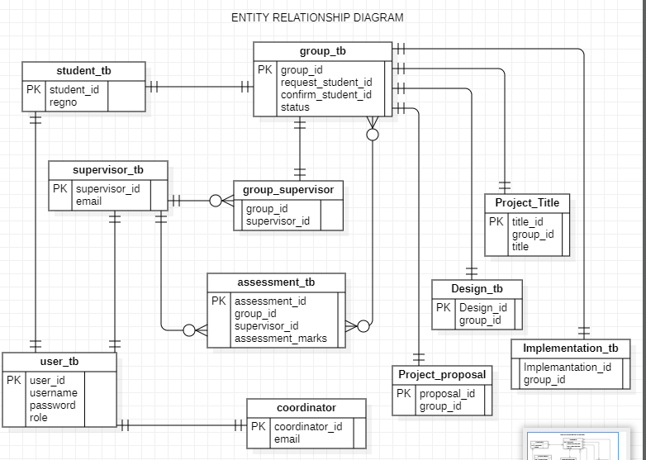

Slide 4
DATA FLOW DIAGRAM LEVEL 0

Slide 5
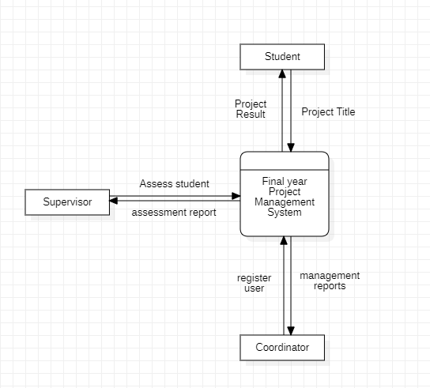

Slide 6
DATA FLOW DIAGRAM LEVEL 1

Slide 7
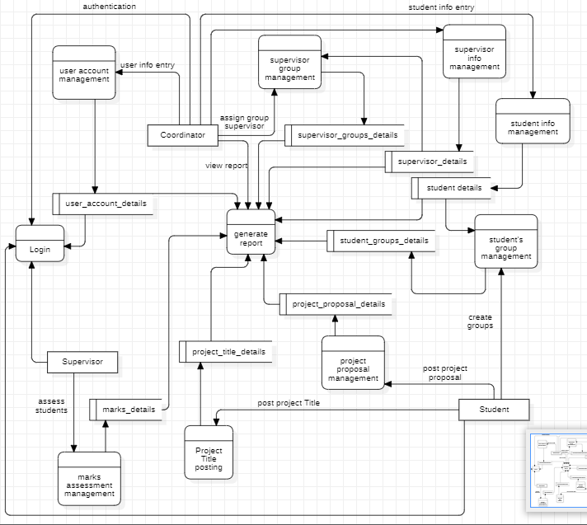

Slide 8
DATA FLOW DIAGRAM LEVEL 2

Slide 9
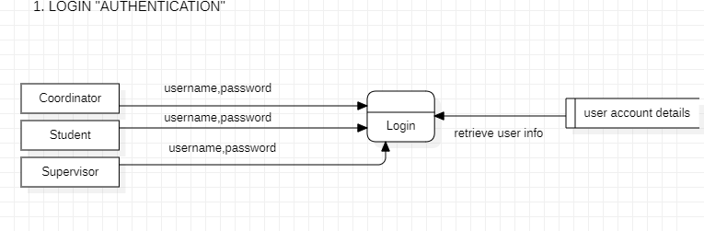
LOGIN “AUTHENTICATION”

Slide 10
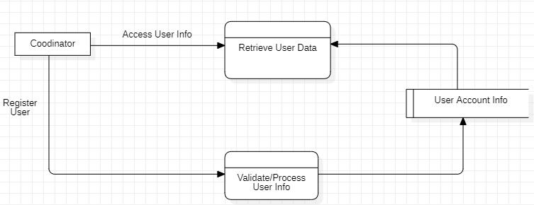
USER ACCOUNT REGISTRATION

Slide 11
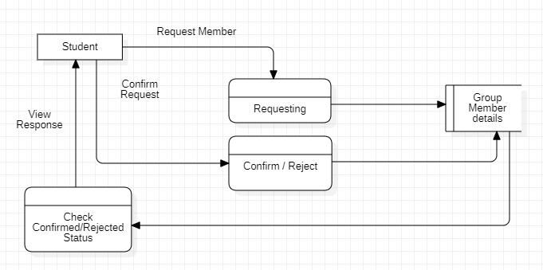
GROUP CREATION

Slide 12
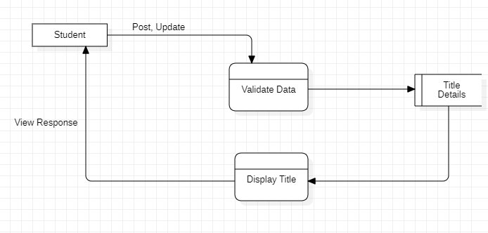
TITLE POSTING

Slide 13
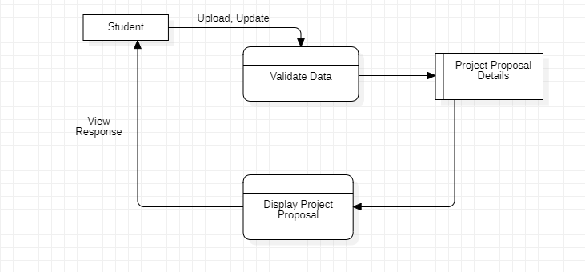
PROPOSAL UPLOAD

Slide 14
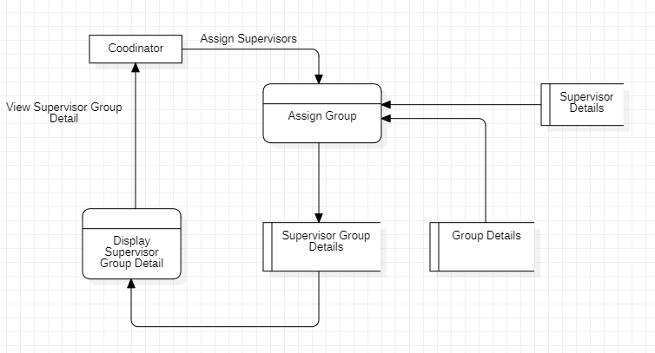
SUPERVISOR –GROUP MANAGEMENT

Slide 15
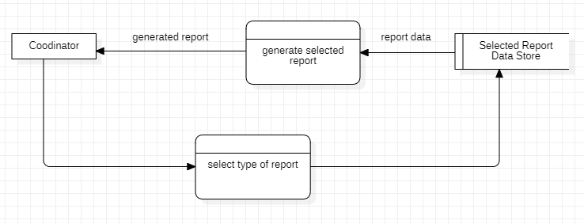
GENERATE REPORT

Slide 16
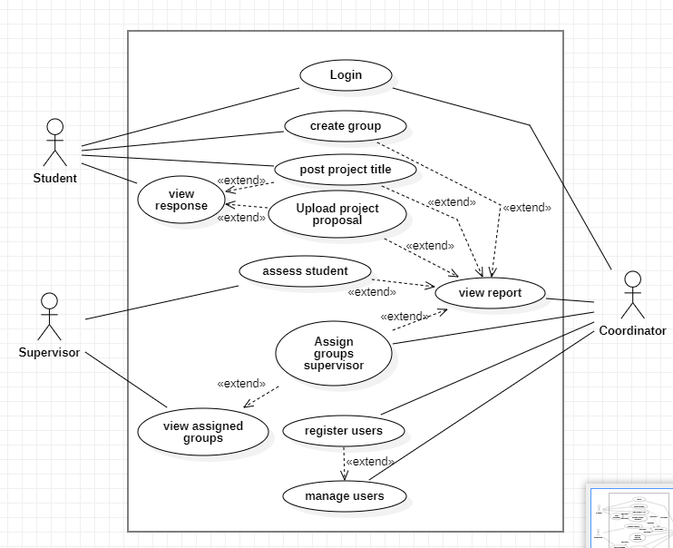
USE CASE DIAGRAM

Slide 17
THANK YOU!!

